Slide 1

A2AForge – Crafting Intelligent Cloud Agents with A2A and MCP
TEAM MEMBERS:
APURVA KARNE (018221801 )
CHANDINI SAISRI UPPUGANTI (018228483 )
HARSHAVARDHAN REDDY (018239936)
ROSHINI JOGA (0182211736)

Slide 2
Problem Statement
The Challenge in current Cloud Infrastructure Management :
Cloud environments (AWS, Azure, GCP) are becoming more complex and dynamic.
Managing EC2, S3, VPC, Lambda, IAM, etc., requires specialized knowledge.
DevOps teams spend significant time on manual, repetitive tasks.
Misconfigurations or human errors can lead to downtime, security risks, or cost overruns.
There is no unified, natural-language interface for cloud operations.
Notes:
Today’s cloud infrastructure landscape has become increasingly complex and dynamic. Organizations rely on a wide range of cloud services—such as EC2, S3, VPC, Lambda, and IAM—to run their applications, but each of these services requires a deep level of specialized knowledge. As a result, cloud engineers and DevOps teams spend a significant amount of time managing configurations, provisioning resources, monitoring systems, and performing repetitive operational tasks.
This manual approach introduces several challenges. First, it increases the operational burden on teams who must constantly keep up with evolving cloud services and best practices. Second, manual configurations create a high risk of human error, which can lead to downtime, security vulnerabilities, compliance issues, or unexpected cost spikes. In large-scale or fast-moving environments, even a small misconfiguration can have major consequences.
Another major challenge is the lack of a unified, natural-language interface for interacting with cloud platforms. Users must rely on complex CLI commands, APIs, or multiple dashboards, making cloud operations inaccessible to non-experts.
Overall, the current process is time-consuming, error-prone, and inefficient—highlighting a strong need for intelligent automation and conversational interfaces that simplify cloud management.

Slide 3
A2AForge
What is A2AForge?
A2AForge is an AI-powered multi-agent automation system that manages cloud infrastructure through natural language commands.
How It Works
Converts user intent into actionable cloud operations
Uses multiple specialized AI agents (EC2, S3, etc.)
Agents communicate autonomously using Google’s A2A Protocol
Executes cloud tasks safely via Anthropic’s MCP tool integration
Leverages OpenAI Agents SDK for reasoning, delegation, and decision-making
Solution Highlights
Reduces manual DevOps workload
Minimizes configuration errors
Enables conversational cloud management
Scalable to any AWS service or cloud provider
Notes:
A2AForge is an AI-powered multi-agent automation system designed to simplify cloud infrastructure management using natural language. Instead of relying on complex command-line tools or multiple AWS consoles, users can simply describe what they want in plain English, and the system takes care of the rest. A2AForge works by translating user intent into actionable cloud operations and then delegating these tasks to specialized agents such as the EC2 Agent or the S3 Agent.
These agents communicate with each other autonomously using Google’s A2A protocol, which enables them to collaborate, request information, and coordinate tasks just like a real DevOps team would. For execution, A2AForge integrates Anthropic’s Model Context Protocol, or MCP, ensuring that AWS operations are performed safely through secure tool interfaces. The OpenAI Agents SDK provides the reasoning layer, helping agents understand tasks, make decisions, and choose when tools should be used.
Overall, A2AForge reduces the manual workload typically handled by DevOps teams, minimizes configuration mistakes, and introduces a fully conversational way to manage cloud resources. Its modular architecture also makes it scalable, allowing support for additional AWS services or even other cloud providers in the future.

Slide 4
What Makes A2AForge Unique?
1. Autonomous Multi-Agent Collaboration
Agents communicate, delegate, and solve tasks without centralized control.
EC2 Agent, S3 Agent, and future agents work together seamlessly.
2. Protocol-Driven Intelligence
Uses Google’s A2A protocol for agent-to-agent messaging.
Integrates Anthropic’s MCP to securely execute AWS operations.
3. Natural Language Cloud Management
Users interact with AWS using plain English (e.g., “Create an EC2 instance”).
No need for CLI, console navigation, or scripting.
4. Modular & Extensible Architecture
New agents (Lambda, RDS, IAM, CloudWatch) can be added easily.
Highly scalable for enterprise-level cloud automation.
5. Production-Inspired Design
Secure credential handling
Region inference
Real-world DevOps patterns mirrored in design
Notes:
A2AForge stands out because it introduces true autonomous multi-agent collaboration to cloud management. Each agent—such as the EC2 Agent or the S3 Agent—can communicate, delegate tasks, and work together without relying on a centralized controller.
This mirrors how real DevOps teams coordinate, making the system far more flexible and intelligent.
A key enabler of this collaboration is the use of Google’s A2A protocol, which allows agents to exchange structured messages and share context. Combined with Anthropic’s MCP, agents can securely execute AWS operations using predefined tools, ensuring safety and consistency while interacting with cloud services.
Another major strength is the natural language interface. Users can simply speak or type instructions like “Create an EC2 instance”, eliminating the need for AWS CLI commands, console navigation, or scripting knowledge. This dramatically lowers the barrier to managing cloud resources.
A2AForge is also built to be modular and extensible. New service agents—for Lambda, RDS, IAM, CloudWatch, and more—can be added easily, making the system highly scalable for enterprise automation.
Finally, the design incorporates real-world production practices, including secure credential handling, region inference, and DevOps-aligned patterns, making the system both practical and future-ready.

Slide 5
High-Level Architecture Overview
Core Components
Coordinator Agent - Routes user requests, interprets intent, and assigns tasks to specialized agents.
EC2 Agent - Handles EC2 lifecycle actions (create, stop, terminate, list).
S3 Agent - Manages S3 bucket operations (create, list, delete, list objects).
Supporting Technologies
A2A Protocol (Google): Enables autonomous agent-to-agent communication.
MCP (Anthropic): Provides secure tool access for real AWS operations.
OpenAI Agents SDK: Powers reasoning, delegation, and tool-use decision-making.
Perplexity API: Enhances natural language understanding.
System Flow (Simplified)
User gives a natural language command
Coordinator Agent interprets intent
Coordinator dispatches task to EC2/S3 Agent
Agent performs tool actions via MCP
AWS executes the requested operation
Response is returned to user
Notes:
A2AForge is built on a set of core components that work together to automate cloud operations intelligently. At the center is the Coordinator Agent, which receives user requests, interprets intent, and decides which specialized agent should handle the task. The EC2 Agent manages the full lifecycle of EC2 instances—creating, stopping, terminating, and listing them. The S3 Agent focuses on S3 bucket operations, including creating, deleting, listing buckets, and retrieving objects. These specialized agents allow the system to scale easily as new services are added.
Google’s A2A protocol enables seamless communication between agents, allowing them to collaborate and share context. Anthropic’s MCP ensures that AWS operations are executed securely through well-defined tool interfaces. The OpenAI Agents SDK provides the reasoning required for intelligent decision-making, delegation, and tool selection. Additionally, the Perplexity API enhances the system’s natural language understanding, making interactions smoother and more intuitive.
The overall system flow is simple and efficient: the user gives a natural language command, the Coordinator interprets it, and the appropriate agent executes the action via MCP. AWS performs the operation, and the result is returned to the user in clear, conversational language.

Slide 6
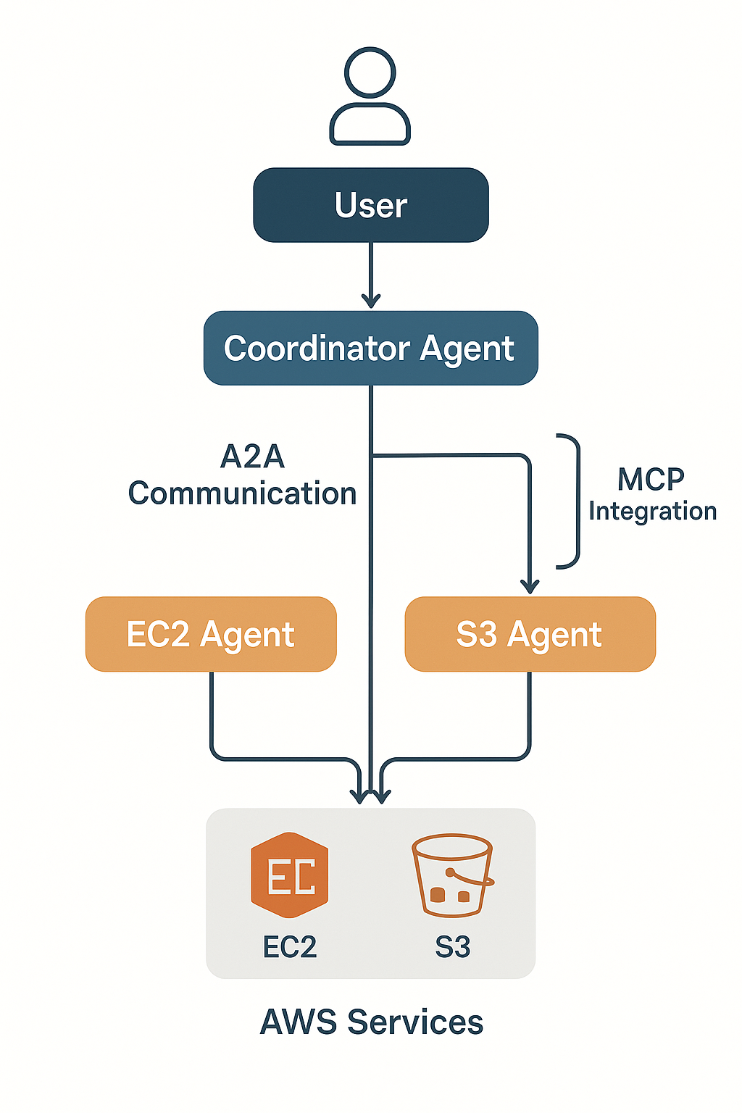
Architecture
Notes:
Our architecture is built around a collaborative multi-agent system designed to automate cloud operations through natural language. At the top, the user interacts with the system by simply issuing a plain-English command. This request is received by the Coordinator Agent, which handles intent recognition and decides which specialized agent should execute the task.
The Coordinator communicates with other agents through Google’s A2A protocol, enabling structured, autonomous agent-to-agent messaging. For execution, each agent uses Anthropic’s MCP, which provides secure tool interfaces for performing real AWS actions.
We currently have two specialized agents: the EC2 Agent, responsible for creating, stopping, terminating, and listing EC2 instances, and the S3 Agent, which manages S3 bucket operations such as creation, deletion, and listing.
Once the correct agent is selected, it performs the AWS operation and returns the result back to the Coordinator, which then delivers a user-friendly response. Overall, this architecture creates a fully automated, intelligent workflow for cloud resource management.

Slide 7
A2A Communication Flow
How Agents Communicate in A2AForge
User Issues Command - Natural language input (e.g., “Create an EC2 instance.”)
Coordinator Agent Interprets Intent - Extracts required parameters, Determines which agent is responsible
A2A Message Exchange Begins - Coordinator sends structured messages to EC2/S3 agents, Agents can request clarification or data from each other, Agents share context and collaborate autonomously
Tool Execution via MCP - MCP allows agents to securely execute AWS actions, Ensures safe, isolated tool usage
AWS Performs the Operation
Example: Launch EC2, create S3 bucket, list resources
Final Response Returned to User
Clear, human-readable result
Notes:
In A2AForge, agent communication is designed to closely mimic how a real DevOps team collaborates. The process begins when the user issues a natural language command—something simple like “Create an EC2 instance.” This input is passed to the Coordinator Agent, which interprets the request, extracts key parameters such as region or instance type, and determines which specialized agent should handle the task.
Once the intent is understood, the A2A communication process begins. The Coordinator sends structured messages to the EC2 Agent or S3 Agent, depending on the job. What makes this powerful is that agents can also communicate with each other—they can ask follow-up questions, request missing information, or share context to make better decisions. This autonomous collaboration enables a high level of flexibility and intelligence.
When the responsible agent is ready to execute, it uses Anthropic’s MCP to safely trigger AWS tools. MCP ensures operations like launching an EC2 instance or creating an S3 bucket happen in a controlled and isolated environment.
Finally, once AWS completes the operation, the agent returns the results to the Coordinator, which delivers a clear, human-friendly response back to the user. This completes a seamless, conversational workflow.

Slide 8
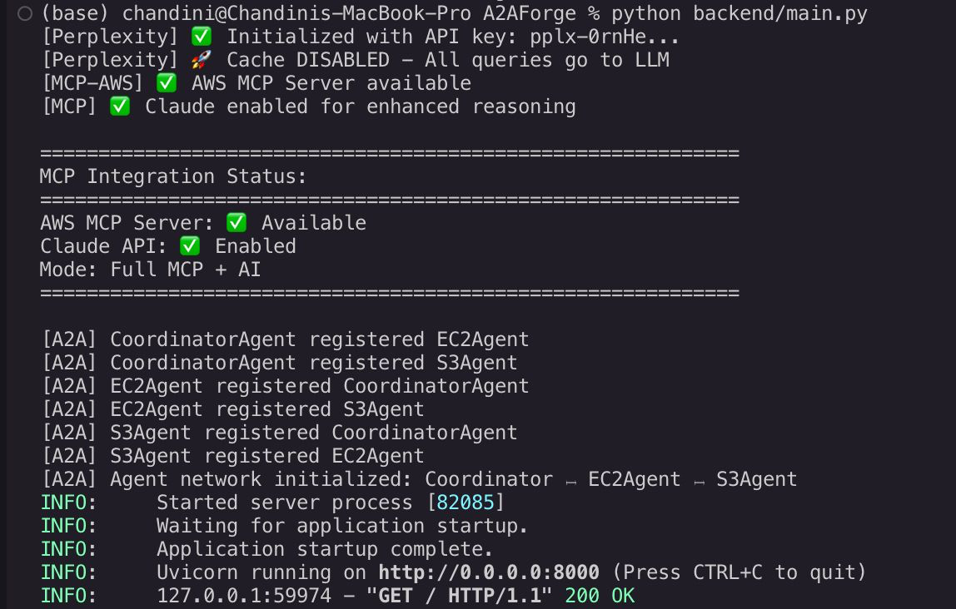
Output Screens

Slide 9
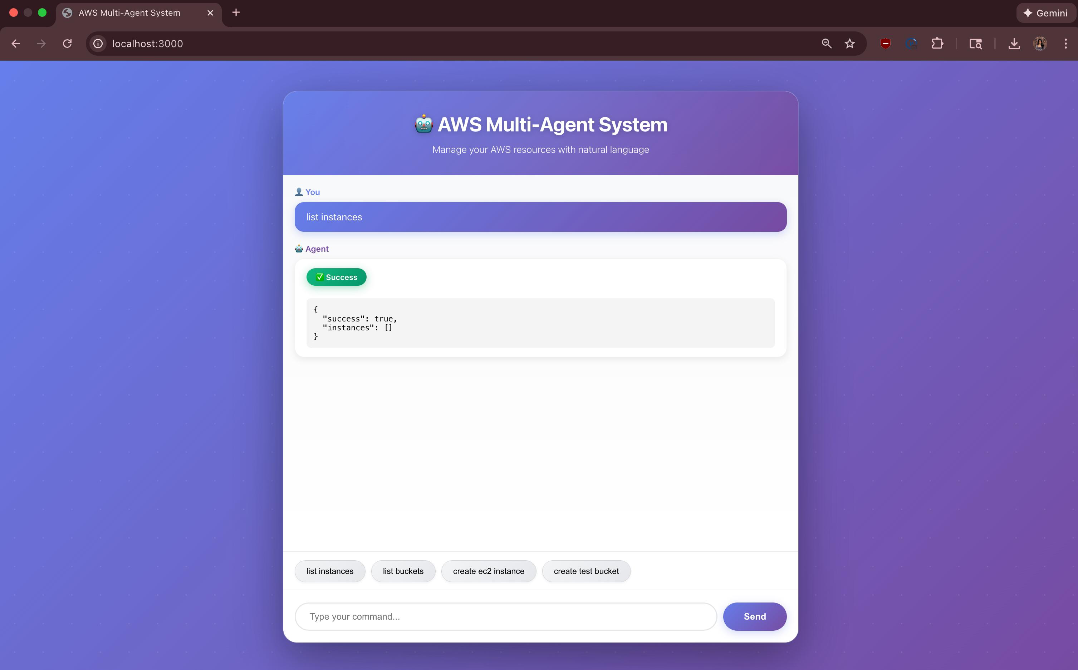
List Instances

Slide 10
Create S3 bucket

Slide 11
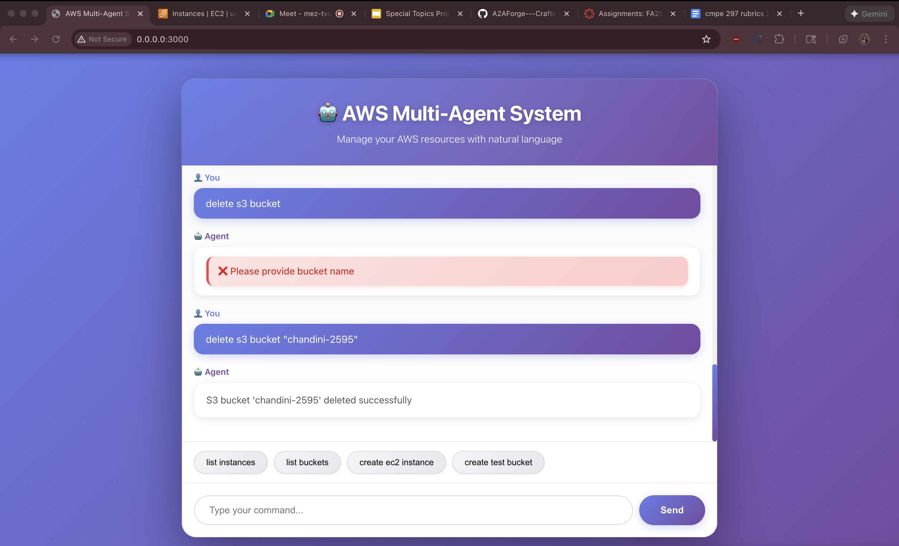
Delete S3 bucket

Slide 12
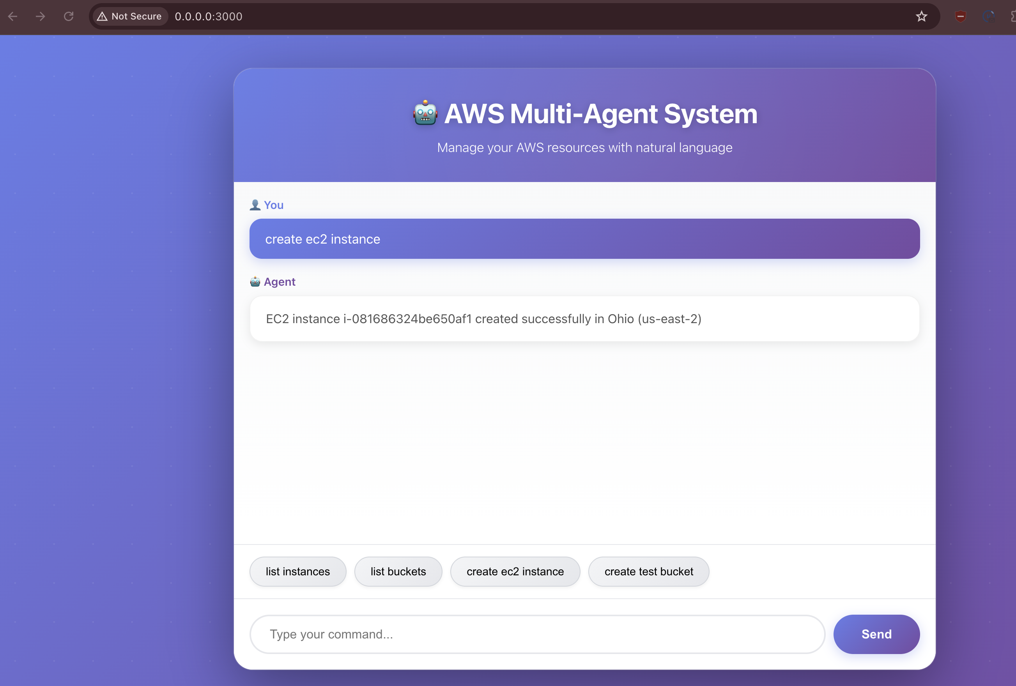
Create EC2 instance

Slide 13
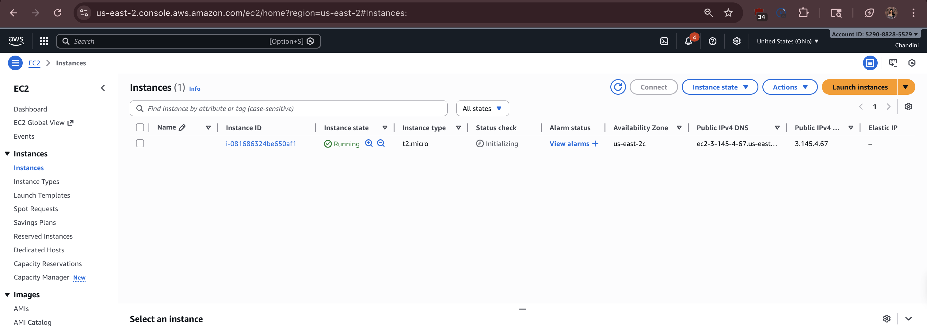

Slide 14
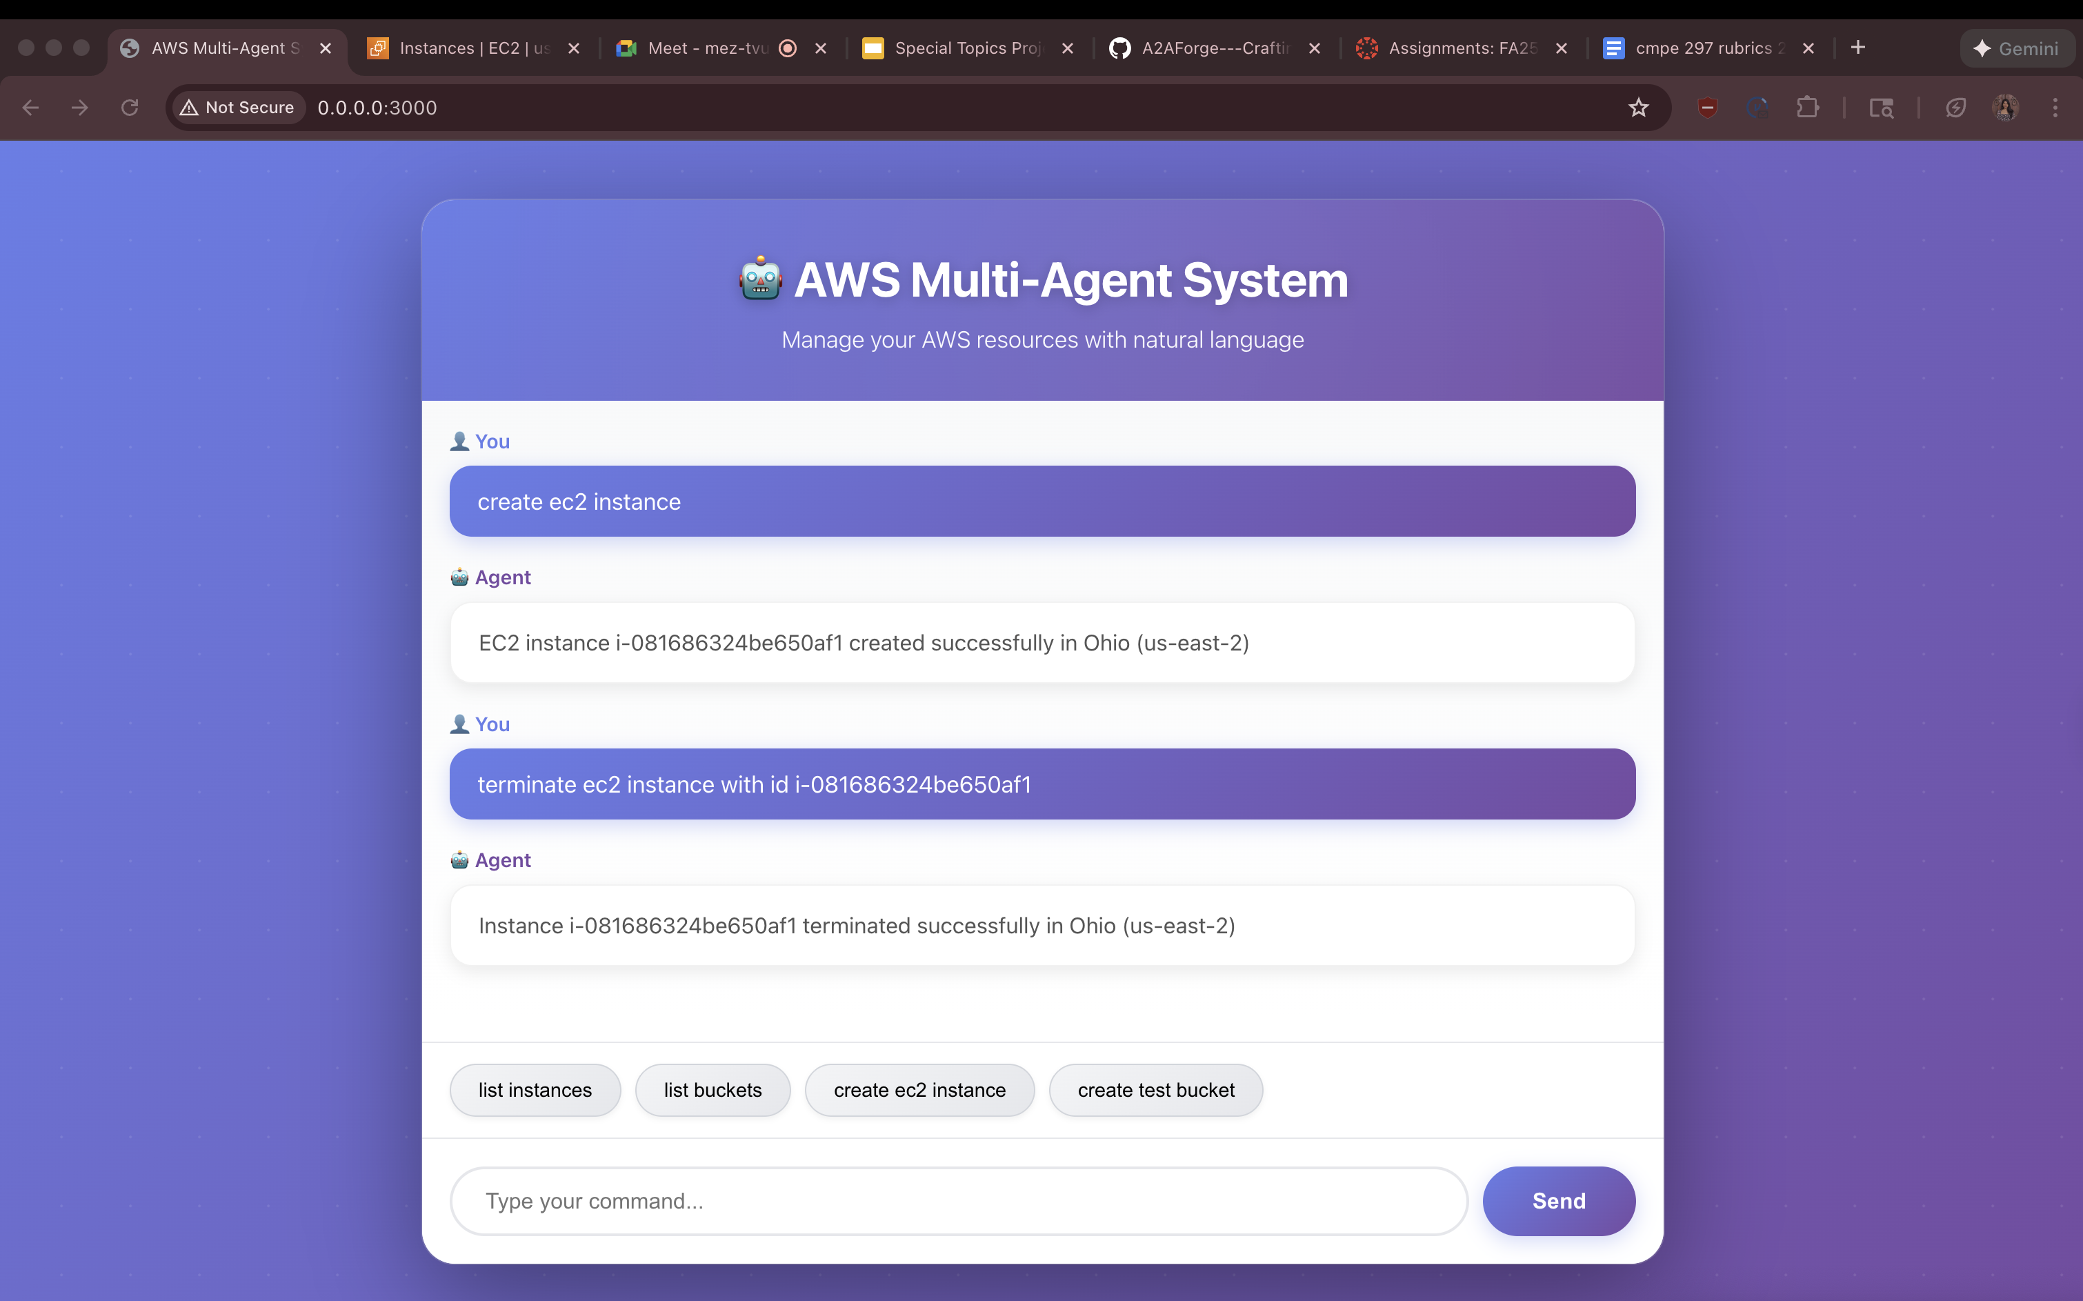
Terminate EC2 instance

Slide 15
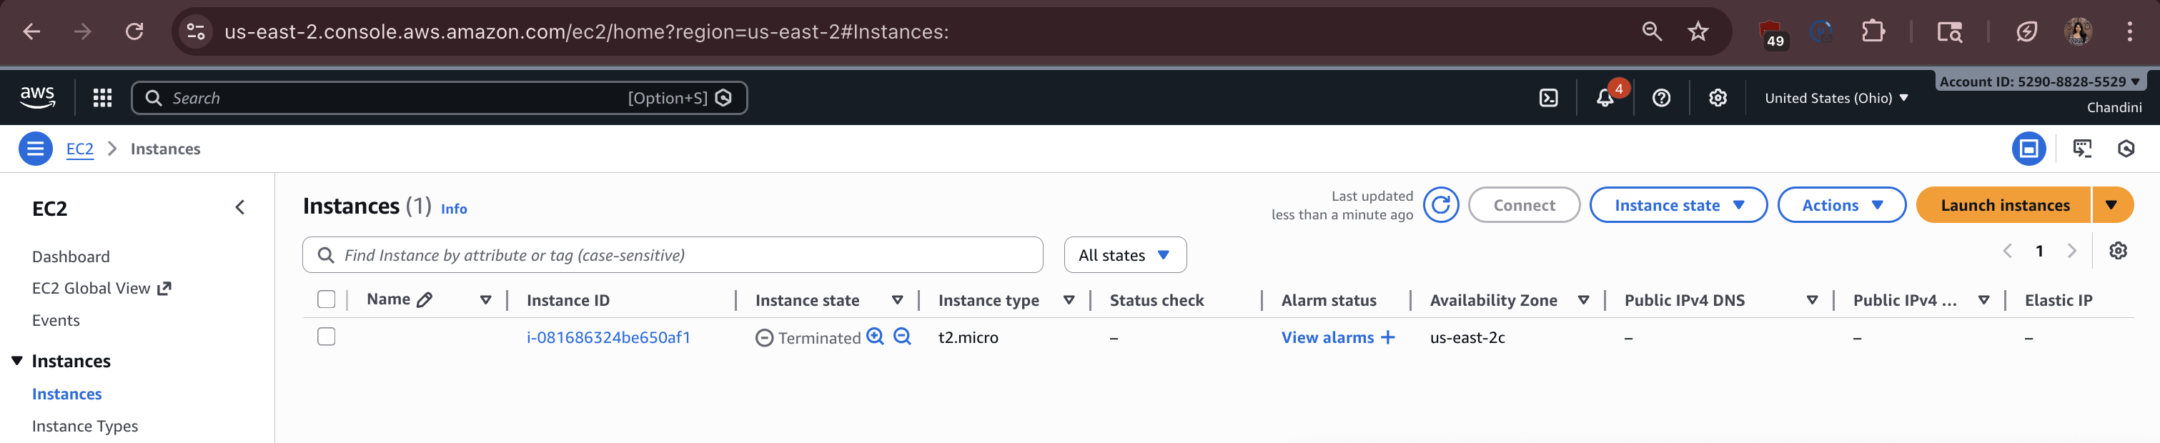

Slide 16
Conclusion
A2AForge: The Future of Cloud Automation
Demonstrates how multi-agent AI systems can transform cloud operations
Simplifies AWS management through natural language interaction
Leverages A2A protocol and MCP to enable autonomous, collaborative agents
Delivers a scalable, modular framework for EC2, S3, and future cloud services
Reduces human effort, minimizes errors, and accelerates DevOps workflows
Key Takeaway
A2AForge proves that cloud infrastructure can be managed intelligently - not through commands, but through conversations.
Looking Ahead
Expanding agents (Lambda, IAM, CloudWatch, RDS)
Advanced cost monitoring and rollback capabilities
Secure, production-grade web UI
Full multi-agent orchestration for enterprise DevOps
Notes:
A2AForge represents a major step forward in the future of cloud automation. Throughout this project, we’ve demonstrated how multi-agent AI systems can fundamentally reshape the way cloud operations are managed. Instead of relying on complex scripts, command-line tools, or manual configurations, A2AForge brings simplicity by allowing users to manage AWS infrastructure through natural language. This dramatically lowers the barrier for cloud management and makes DevOps more accessible and efficient.
By combining Google’s A2A protocol with Anthropic’s MCP, A2AForge enables agents that communicate, collaborate, and execute cloud tasks autonomously. This architecture is both scalable and modular, supporting EC2 and S3 today while being fully ready to expand into Lambda, CloudWatch, IAM, RDS, and many more services. The result is a system that not only reduces human effort but also minimizes configuration errors and accelerates overall cloud workflows.
The key takeaway is simple: A2AForge proves that cloud infrastructure doesn’t have to be controlled through commands—it can be managed through conversations.
Looking ahead, we plan to expand the agent ecosystem, add advanced cost monitoring, develop rollback mechanisms, and build a secure, production-ready UI. Our long-term vision is full multi-agent orchestration for enterprise-level DevOps automation.

Slide 17

Thank you !

